Slide 1
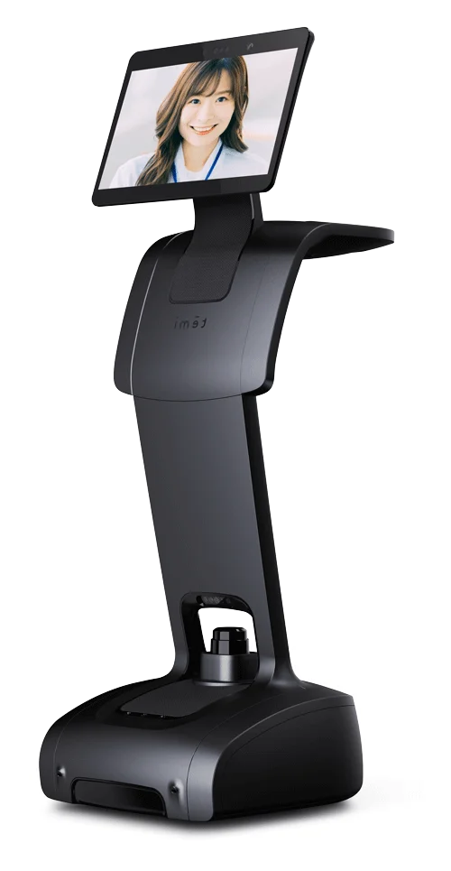

Slide 2


Slide 3

____
|()_()|
|^|
Temi

Slide 4




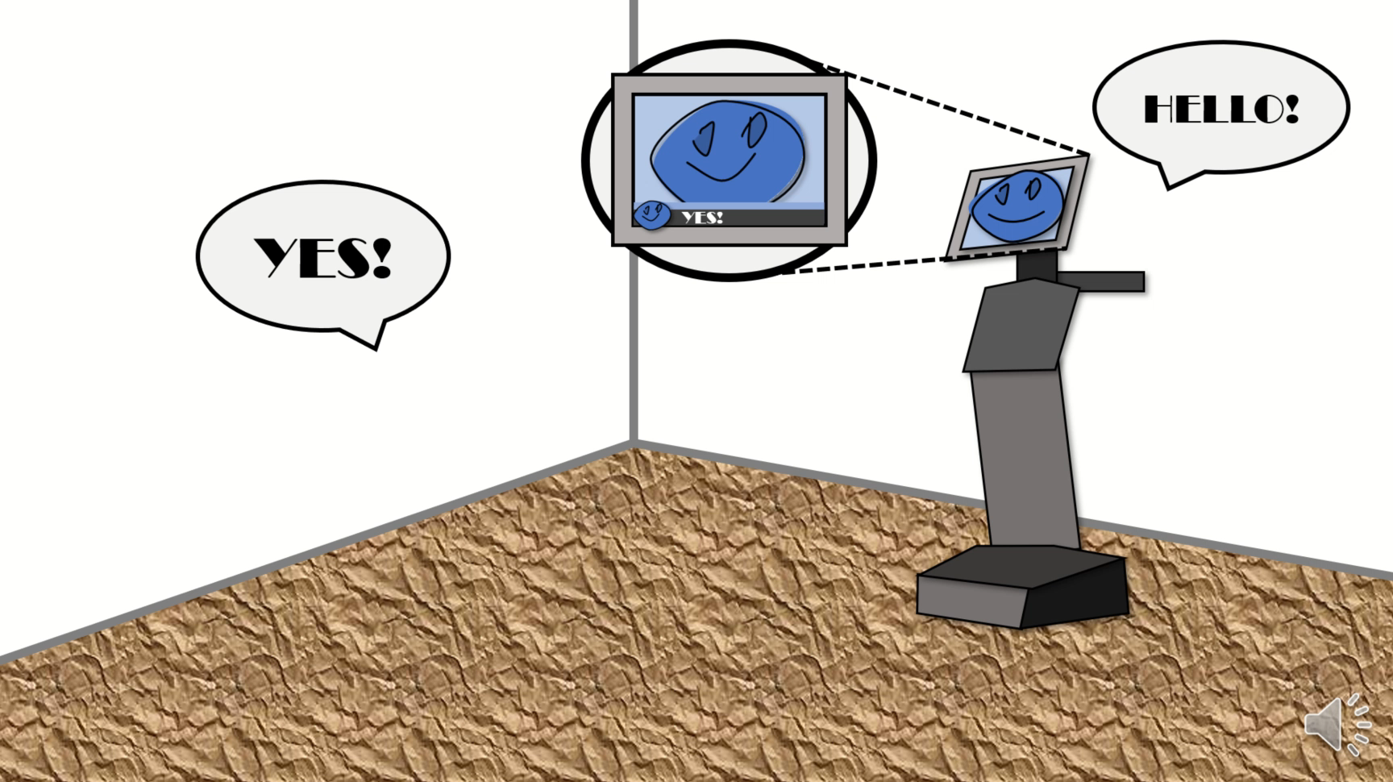
HELLO!
()()()
YES!

Slide 5
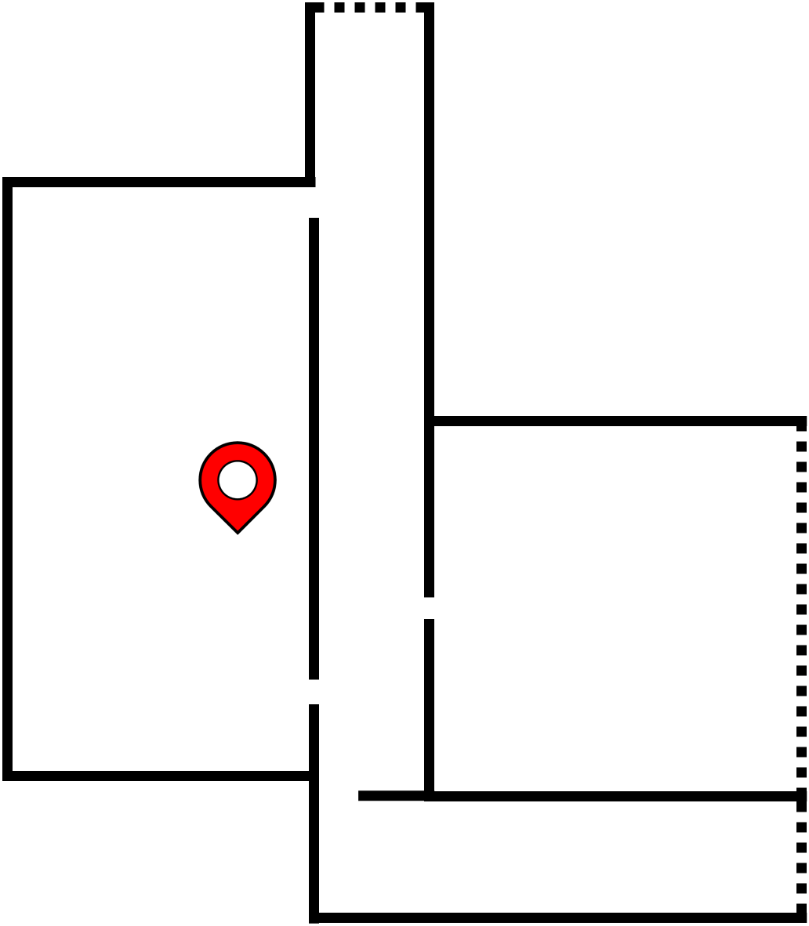

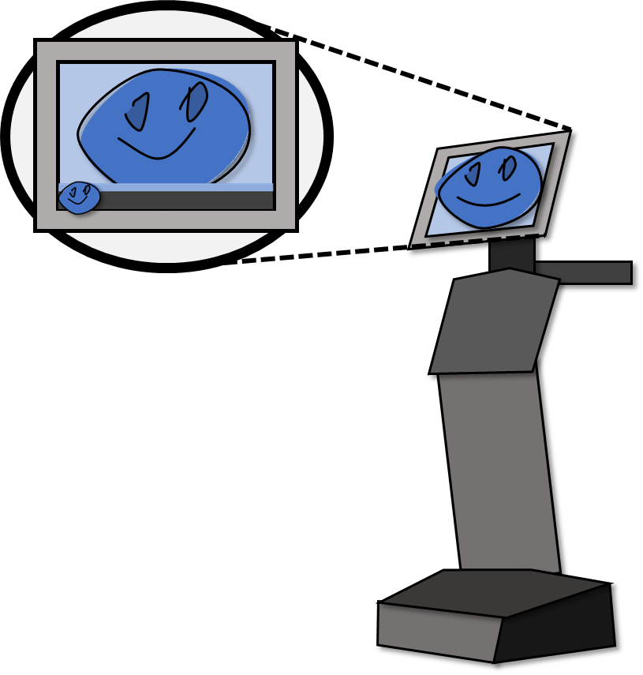
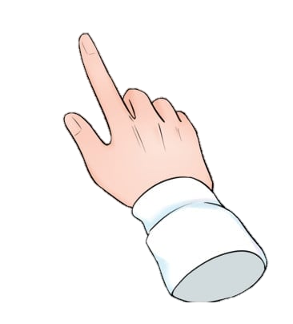
Only talk to Temi when the blue bar appears on the screen
When looking at the map, it can be moved around and zoomed on. Give it a try if!

Slide 6
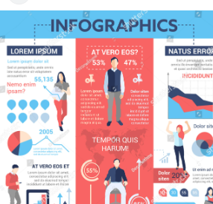


HOW TO USE TEMI
TALKING WITH TEMI
USING TEMI MAP
TEMI
ROBOT
Only talk to Temi when the blue bar appears on the screen!
When looking at the map, it can be moved around and zoomed in. Give it a try!

Slide 8
